Slide 1
Patten Name and classification
Pattern Name : Singleton
Classification: Creational Pattern

Slide 2
Creational Pattern:Singleton
Intent
Ensure a class only has one instance, and provide a global point of access to it.

Slide 3
Singleton
Motivation
It's important for some classes to have exactly one instance. Although there can be many printers in a system, there should be only one printer spooler. There should be only one file system and one window manager. A digital filter will have one A/D converter. An accounting system will be dedicated to serving one company.
How do we ensure that a class has only one instance and that the instance is easily accessible? A global variable makes an object accessible, but it doesn't keep you from instantiating multiple objects.
A better solution is to make the class itself responsible for keeping track of its sole instance. The class can ensure that no other instance can be created (by intercepting requests to create new objects), and it can provide a way to access the instance. This is the Singleton pattern

Slide 4
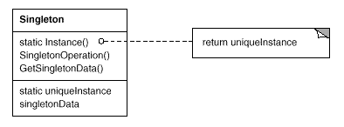
Singleton
Structure

Slide 5
Singleton
Participants
Singleton
defines an Instance operation that lets clients access its unique instance. Instance is a class operation (that is, a class method in Smalltalk and a static member function in C++).
may be responsible for creating its own unique instance.

Slide 6
Example
A bank may have many branches but only uses one banking system.
A company may have only 1 database Access class.

Slide 7
Singleton
Related Patterns
Abstract Factory
Builder
Prototype

Slide 8
Patten Name and classification
Pattern Name : Prototype
Classification: Creational Pattern

Slide 9
Intent
The prototype pattern specify the kinds of objects to create using a prototypical instance, and create new objects by copying this prototype.
Useful when creating an instance is usually:
Time-consuming
Very complex

Slide 10
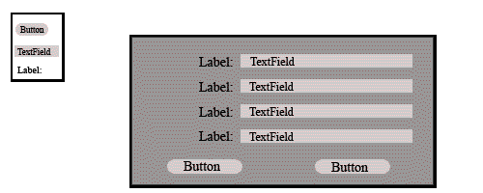
Motivation
An example of the Prototype design pattern would be in a GUI building tool
For each graphic element which the user may customize and add to the application interface (buttons, text boxes, etc.), the user has many options to choose for style, color, font, size, etc.
the GUI building tool need only call the instance's clone() method each time it is dragged from the palette to the GUI, regardless of the specific class selected by the user.

Slide 11
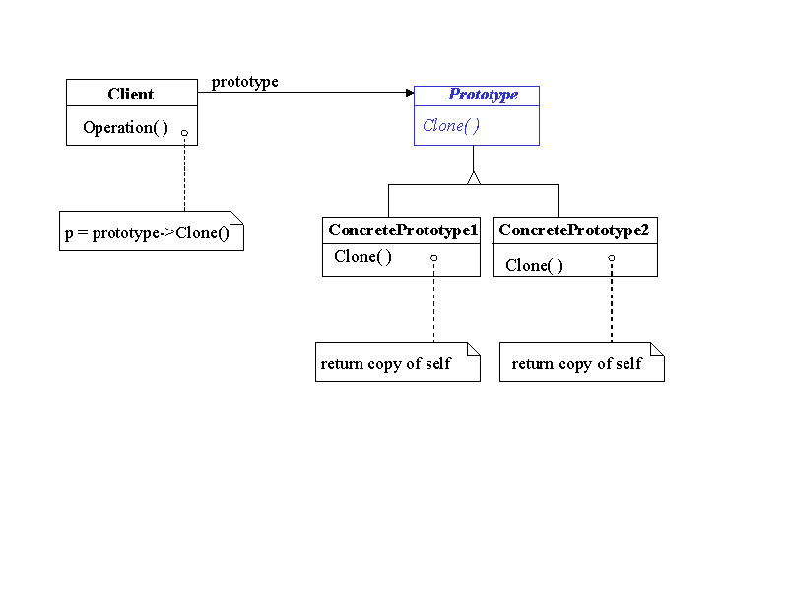
Structure

Slide 12
Participants
Participants in the prototype pattern
Client - The client object asks the prototype to clone itself
Prototype - Data object defining an interface for creating clones of its self
A "clone" function, returning a copy of the original object
Concrete Prototype - Implements the cloning operation defined in the Prototype class
Copies the data and state of the original object

Slide 13
Patten Name and classification
Pattern Name : Abstract Factory
Classification: Creational Pattern

Slide 14
Intent
Provide an interface for creating families of related or dependent objects without specifying their concrete classes.
A hierarchy that encapsulates: many possible “platforms”, and the construction of a suite of “products”.
The new operator considered harmful.

Slide 15
Motivation
Create an interface for creating sets of dependant or related instances that implement a set of abstract types. The Abstract Factory coordinates the instantiation of sets of objects that have varying implementations in such a way that only legitimate combinations of instances are possible, and hides these concrete instances behind a set of abstractions.
Reference:http://www.netobjectives.com/PatternRepository/index.php?title=TheAbstractFactoryPattern#Motivation

Slide 16
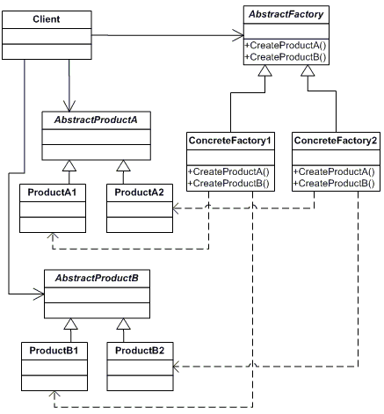
Structure

Slide 17
Participants
The classes and/or objects participating in this pattern are:
AbstractFactory (ContinentFactory)
Declares an interface for operations that create abstract products
ConcreteFactory (AfricaFactory, AmericaFactory)
Implements the operations to create concrete product objects
AbstractProduct (Herbivore, Carnivore)
Declares an interface for a type of product object
Product (Wildebeest, Lion, Bison, Wolf)
Defines a product object to be created by the corresponding concrete factory
Implements the AbstractProduct interface
Client (AnimalWorld)
Uses interfaces declared by AbstractFactory and AbstractProduct classes

Slide 18
Example
The purpose of the Abstract Factory is to provide an interface for creating families of related objects, without specifying concrete classes. This pattern is found in the sheet metal stamping equipment used in the manufacture of Japanese automobiles. The stamping equipment is an Abstract Factory which creates auto body parts. The same machinery is used to stamp right hand doors, left hand doors, right front fenders, left front fenders, hoods, etc. for different models of cars. Through the use of rollers to change the stamping dies, the concrete classes produced by the machinery can be changed within three minutes.

Slide 19
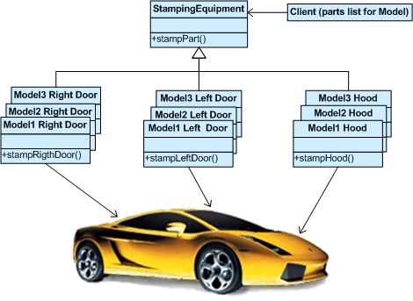

Slide 20
Patten Name and classification
Pattern Name :Builder
Classification: Creational Pattern

Slide 21
INTENT:
The Builder Pattern separates the construction of a complex object from its representation so that the same construction process can create different representations.

Slide 22
MOTIVATION:
The most common motivation for using Builder is to simplify the client code which creates the complex object. The main advantage will be client can still make the object but without knowing what actually is happening inside.
Consider an example of creating different vehicles like car, motorcycle and bus. What builder helps us to simplify here is giving the client the complete vehicle with the only information about what is the type. Client does not need to worry how the different vehicles are being created.

Slide 23
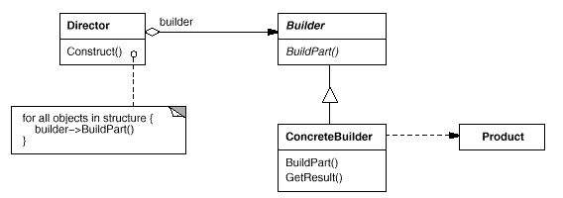
STRUCTURE:

Slide 24
PARTICIPANTS
Director
Object is responsible for the construction process of the complex object but deleg ates the actual creation and assembly to the Builder interface.
Builder
Object specifies the interface for creating
parts of the complex object.

Slide 25
PARTICIPANTS
Product
It represents the complex object that is created by the ConcreteBuilder objects. The Product consists of multiple parts that are created separately by the ConcreteBuilder objects.
Concrete Builder
Objects create and assemble the parts that make up the Product through the Builder interface.

Slide 26
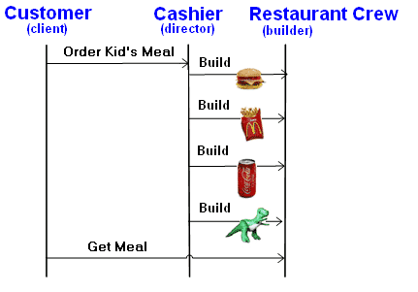
EXAMPLE:

Slide 27
Patten Name and classification
Pattern Name : Factory
Classification: Creational Pattern

Slide 28
Intent
Define an interface for creating an object, but let subclasses decide which class to instantiate. Factory Method lets a class defer instantiation to subclasses.
Defining a “virtual” constructor.
The new operator considered harmful.

Slide 29
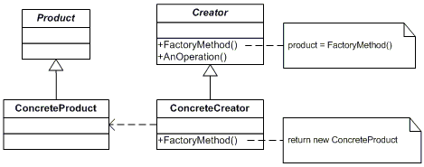
UML Class Diagram:

Slide 30
PATICIPANTS:
1. Product:
Defines the interface of objects the factory method creates.
2. ConcreteProduct:
Implements the Product interface.
3. Creator:
Declares the factory method, which returns an object of type Product. Creator may also define a default implementation of the factory method that returns a default ConcreteProduct object. May call the factory method to create a Product object.
4. ConcreteCreator:
Overrides the factory method to return an instance of a ConcreteProduct.

Slide 31
CONCEPTS:
1. In object-oriented computer programming, a factory is an object for creating other objects.
2. It is an abstraction of a constructor, and can be used to implement various allocation schemes.
3. A factory object has typically a method for every kind of object it is capable of creating. These methods optionally accept parameters defining how the object is created and return the object created.
4. Factory Methods are used in situations where getting hold of an object is more complex than simply creating a new one.

Slide 32
CONCEPTS (continue):
5. The factory object might decide to create the object's class (if applicable) dynamically, return it from a pool, initialize the object, or perform other manipulations on the object instance.
6. Factory Methods are the basis for several design patterns.
7. The "Factory method pattern", the "Builder" or the "Singleton" are one of several "GoF patterns" that realize this concept.
8. The "Abstract factory pattern" generalizes this method to build collections of factories.

Slide 33
Patten Name and classification
Pattern Name : Decorator
Classification: Structural Pattern

Slide 34
Intent
Attach additional responsibilities to an object dynamically.
More flexibility than static inheritance

Slide 35
Motivation
Inheriting responsibilities from another class attaches them to every subclass instance statically
This is inflexible
“Sometimes we want to add responsibilities to individual objects not to an entire class” [GoF95]

Slide 36
Motivation…
A flexible approach is to enclose the component in another object that adds the functionality. The object is the decorator.
Decorator adds functionality to objects dynamically
The decorator class is transparent to component’s clients
Transparency allows an unlimited number of added responsibilities

Slide 37
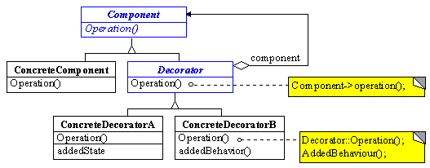
Structure

Slide 38
Participants
Component
Define the interface for objects that can have responsibilities added to them dynamically.
Concrete Component
Defines an object to which additional responsibilities can be attached.
Decorator
Maintains a reference to a Component object and defines an interface that conforms to Component’s interface.
Concrete Decorator
Adds responsibilities to the component.

Slide 39
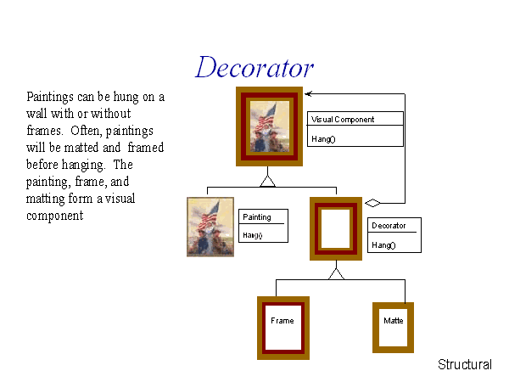
Example

Slide 40
Patten Name and classification
Pattern Name :Facade
Classification: Structural Pattern

Slide 41
Intent
Provide a unified interface to a set of interfaces in a subsystem. Facade defines a higher-level interface that makes the subsystem easier to use.

Slide 42
Motivation
Structuring a system into subsystems helps reduce complexity. A common design goal is to minimize the communication and dependencies between subsystems. One way to achieve this goal is to introduce a facade object that provides a single, simplified interface to the more general facilities of a subsystem.

Slide 43
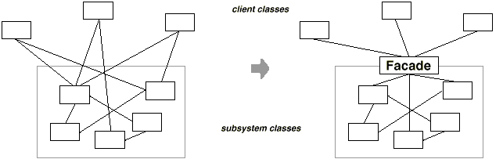
Facade

Slide 44
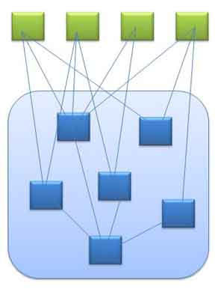
Diagram representing complex subsystem(in blue) and its clients(in green)

Slide 45
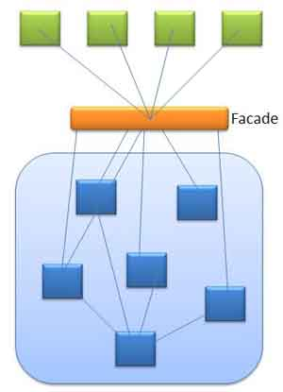
Diagram representing façade between subsystem(in blue) and its clients(in green)

Slide 46
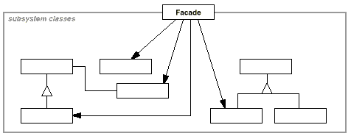
Structure

Slide 47
Participants
Facade
knows which subsystem classes are responsible for a request.
delegates client requests to appropriate subsystem objects.
subsystem classes
implement subsystem functionality.
handle work assigned by the Facade object.
have no knowledge of the façade.

Slide 48
Example
Event organizers
They organize event and we’re not concerned how they perform their tasks and how they manage. We just want the work done. So, they act like Façade.

Slide 49
Related Patterns
Abstract Factory
Mediator

Slide 50
Patten Name and classification
Pattern Name :Proxy
Classification: Structural Pattern

Slide 51
Intent
Provide a surrogate or placeholder for another object to control access to it.
Also Known As
Surrogate

Slide 52
Motivation
One reason for controlling access to an object is to defer the full cost of its creation and initialization until we actually need to use it.

Slide 53
Structure

Slide 54
Participants
Proxy (ImageProxy)
maintains a reference that lets the proxy access the real subject.
provides an interface identical to Subject's so that a proxy can by substituted for the real subject.
controls access to the real subject and may be responsible for creating and deleting it.

Slide 55
Example
Consider a document editor that can embed graphical objects in a document. Some graphical objects, like large raster images, can be expensive to create.
But opening a document should be fast, so we should avoid creating all the expensive objects at once when the document is opened.
Because not all of these objects will be visible in the document at the same time.
These constraints would suggest creating each expensive object on demand, which in this case occurs when an image becomes visible.

Slide 56
Patten Name and classification
Pattern Name :Adapter
Classification: Structural Pattern

Slide 57
Adapter
Intent:
Convert the interface of a class into another interface clients expect. Adapter lets classes work together that couldn't otherwise because of incompatible interfaces.
Motivation:
Sometimes a class that's designed for reuse isn't reusable only because its interface doesn't match the domain-specific interface an application requires.
Example
Design Editor

Slide 58
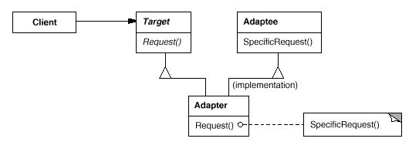
Structure:
A class adapter uses multiple inheritance to adapt one interface to another:

Slide 59
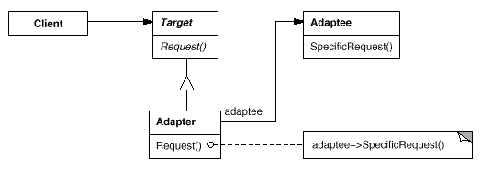
Structure
An object adapter relies on object composition

Slide 60
Adapter
Participants
Target (Shape)
defines the domain-specific interface that Client uses.
Client (DrawingEditor)
collaborates with objects conforming to the Target interface.
Adaptee (TextView)
defines an existing interface that needs adapting.
Adapter (TextShape)
adapts the interface of Adaptee to the Target interface.

Slide 61
Example:
We have used some library where we have Add function which takes two integer and provides the sum of them. Now when upgrading the libray we find that the library has changed the Add function such that it takes 2 floating point number. Now one option could be to change all the client code where we have used the Add method or other option is to have an Adapter.

Slide 62
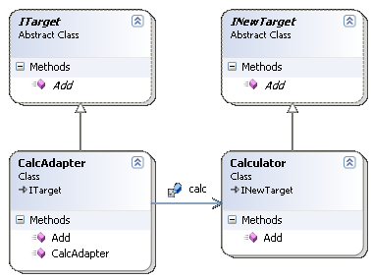
Example:
CalcAdapter calls the necessary library function after making the necessary changes (in our example conversion between the data types)

Slide 63
Patten Name and classification
Pattern Name :Bridge
Classification: Structural Pattern

Slide 64
Intent:
Decouple an abstraction from its implementation so that the two can vary independently.
Publish interface in an inheritance hierarchy, and bury implementation in its own
inheritance hierarchy.
Beyond encapsulation, to insulation

Slide 65
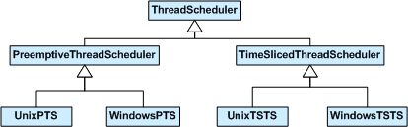
Motivation:
Consider the domain of thread scheduling.

Slide 66
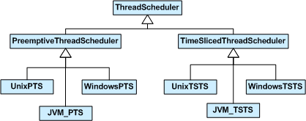
Without Bridge pattern

Slide 67
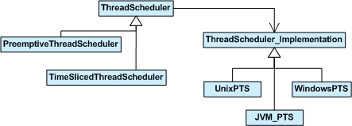
With Bridge pattern:

Slide 68
Participants
Abstraction (Thread scheduler):
- define the abstraction’s interface
- maintains a reference to an object of type Implementer
Refined Abstraction (Preemptive thread scheduler):
- extends the interface defined by Abstraction

Slide 69
Participants (continue)
Implementer (threadImp):
- defines an interface for implementation
classes.
Concrete Implementer (win,unix):
- implements the Implementer’s interface

Slide 70
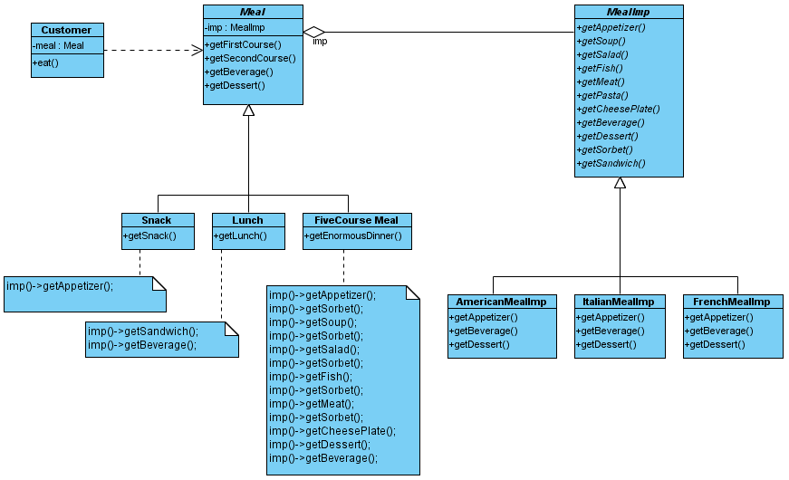
A Meal Example:

Slide 71
Patten Name and classification
Pattern Name : Iterator
Classification: Behavioural Pattern

Slide 72
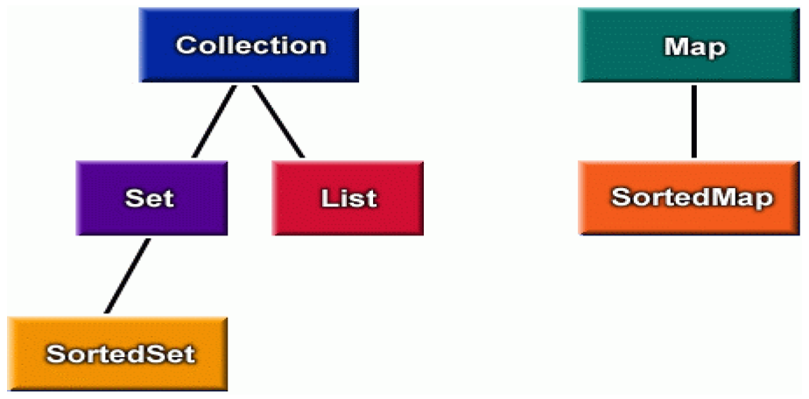
Iterator
objects that traverse collections

Slide 73
Iterator Intent
Important is that a collection should provide a way to access its elements without exposing its internal structure.
We should have a mechanism to traverse in the same way a list or an array. It doesn't matter how they are internally represented.

Slide 74
Iterator Intent (Cont.)
Provide a way to access the elements of an aggregate object sequentially without exposing its underlying representation.
The abstraction provided by the iterator pattern allows you to modify the collection implementation without making any changes outside of collection.
It enables you to create a general purpose GUI component that will be able to iterate through any collection of the application.
It boost productivity, and reduce configuration management.

Slide 75
Motivation
A c++ pointers uses the ‘*’ to access the data it points to.
The arrow(-->) operator is combination of ‘*’ and ‘.’
In array we use prefix or postfix increment to move to the next item.
In linked list we’ve to follow the next pointer
We can overload the ++ operator
All operators can be overloaded in c++
This creates the possibility of user defined fancy pointers or iterators

Slide 76
Motivation cont..
We use them to create generic code which leads to Generic Programming
In graph algorithms we need to visit all neighbors of given node. In order to visit neighbor nodes we make the traversal possible by using some pointers but here it is made possible by using iterators which shows generic programming. It feels as if it were a simmple array.
Both I++ or ++I can be used to visit the neighbors of a particular node.

Slide 77
Motivation cont..
General example
In office settings to the Executive Director, the filing system is confusing and illogical, but the secretary is able to access files quickly and efficiently.

Slide 78
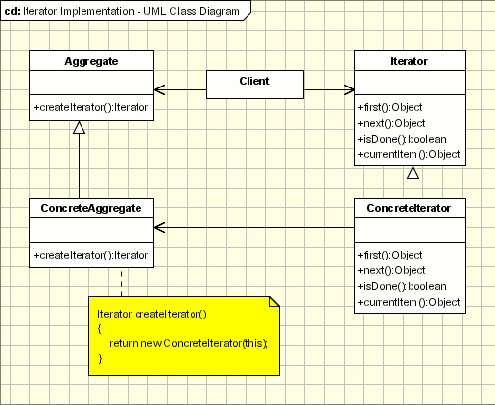
Iterator pattern: Collaboration

Slide 79
Iterator pattern Participants
The key participants in this pattern are:
The Iterator, which provides an (virtual) interface for moving through a collection of things
The Aggregate, which defines the (virtual) interface for a collection that provides iterators
The Concrete-Iterator, which is the class that inherits/extends/implements the Iterator
The Concrete-Aggregate, which is the class that inherits/extends/ implements the Aggregate
This pattern is also known as cursor
Iterator is a pattern that shows why we would use multiple inheritance
Or interfaces in Java

Slide 80
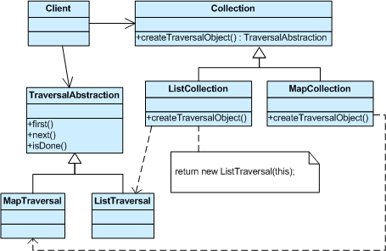
Iterator Structure

Slide 81

What is a Template
Something that serves as a model for others to copy.

Slide 82
Intent:
A template method defines the program skeleton of an algorithm
One or more of the algorithm steps can be overridden by subclasses to allow differing behaviours while ensuring that the overarching algorithm is still followed.

Slide 83
In object-oriented programming, first a class is created that provides the basic steps of an algorithm design.
These steps are implemented using abstract methods. Later on, subclasses change the abstract methods to implement real actions. Thus the general algorithm is saved in one place but the concrete steps may be changed by the subclasses.

Slide 84
Motivation
If we take a look at the dictionary definition of a template we can see that a template is a preset format, used as a starting point for a particular application so that the format does not have to be recreated each time it is used. On the same idea is the template method is based. A template method defines an algorithm in a base class using abstract operations that subclasses override to provide concrete behavior.

Slide 85
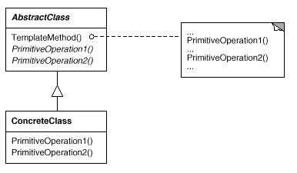
Structure

Slide 86
Participants:
AbstractClass (Application) :
Defines abstract primitive operations that concrete subclasses define to implement steps of an algorithm.
Implements a template method defining the skeleton of an algorithm. The template method calls primitive operations as well as operations defined in AbstractClass or those of other objects.

Slide 87
Continued…
ConcreteClass (MyApplication):
Implements the primitive operations to carry out subclass-specific steps of the algorithm

Slide 88
Example
Home builders use the Template Method when developing a new subdivision. A typical subdivision consists of a limited number of floor plans with different variations available for each. Within a floor plan, the foundation, framing, plumbing, and wiring will be identical for each house. Variation is introduced in the later stages of construction to produce a wider variety of models.

